Slide 1
TA Assignment Final Presentation
Stephanie Lam
Hannah Ifekoya
Aaron Xu
Neel Singh
Yuvanesh Rajamani
Hao Zhu
CSCE 606
4/24/2025

Slide 2



Problem
No Platform
Current TAMU platform was using Google Forms as the main way for students to sign up for positions
Position Assignment
Prioritization for certain students and easy management of assignments were not possible
Admin Control
Certain operations had to be completed manually by previous administrators

Slide 3




Product
Google Login Authentication
Role-based Application Views
Recommendation System
Secure login using Google OAuth that only authorized users from TAMU can access the platform
The system dynamically adapts the user interface based on the user’s roles
Faculty can submit digital recommendations for students directly through the platform
Admin Operation Controls
Application Position Sorting
Admins are granted elevated privileges to manage user data, applications, and other system-wide operations
Applications are sorted based off certain requirements and preferences, allowing the algorithm to quickly sort positions

Slide 4

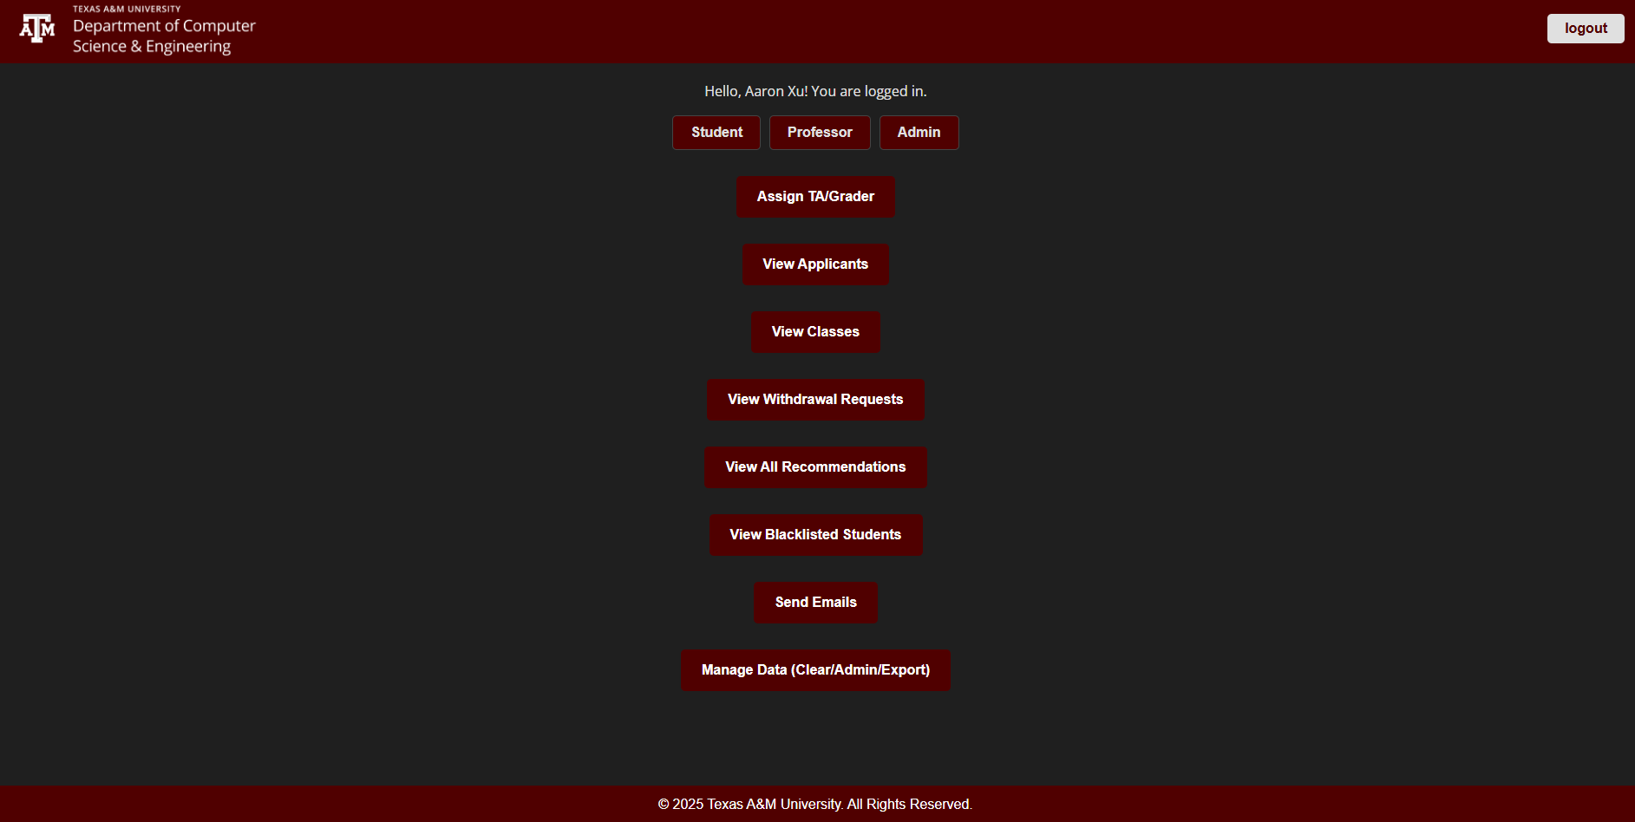
Design
Seamless Integration
Interface
Easy-to-use interface for student and faculty
Single Platform
All features - TA applications, recommendations - under one roof
No IT Needed
Admin can manage the system independently all from the platform

Slide 5

User Story
As a student, I want to be able to apply to multiple positions within a single application
As a faculty member, I want to be able to recommend specific students that I want to personally work with
As an admin, I want to be able to view and manage all data on the platform to ensure proper functionality

Slide 6

Challenges
No Access to TAMU Directory API
Couldn’t verify user roles through the official TAMU directory API
Legacy Code & Manual Processes
Inherited old legacy code and had to update and integrate it during platform development
No Access to TAMU Login System
Not able to integrate with TAMU’s internal authentication services

